Slide 1






Emerging Technology Trends
AKSHAY KHARBANDA
8th February 2024

Slide 2



OUTLINE
Executive Summary
Introduction
Methodology
Results
Visualization – Charts
Dashboard
Discussion
Findings & Implications
Conclusion
Appendix

Slide 3

EXECUTIVE SUMMARY
To understand the technology trends in the IT industry to identify future skill requirements
Data for emerging technologies & databases is collected via:
APIs
Web Scraping
Online survey data from an open-source website
Findings show that Javascript is currently the most popular programming language and expected to be so in future
In Databases, MySQL has the highest usage but PostgreSQL is expected to have most demand in future
Trends show that survey respondents are mostly Male, from USA and 28 years of age

Slide 4

INTRODUCTION
This ppt uses data analytics to highlight current and projected trends in skills related to the programming languages, databases, platforms and web frames
Following inquiries were investigated:
Most popular programming languages & databases
Demographics of the respondents- age, country, education level
This report is useful for HR, IT professionals and anybody else in the IT sector who has interest regarding current & emerging trends

Slide 5

METHODOLOGY
Data Collection Methods
APIs
Web Scraping
Online survey data from open-source website
Data Wrangling done via Pandas library in Python to:
Identify & remove duplicates
Identify & remove missing values
Data Analysis to understand distribution & correlation of respondent factors
Data is visualized to find:
Distribution via Histogram & Boxplots
Relationships via Scatter & Bubble plots
Composition via pie & stacked charts
Comparison via line & bar charts

Slide 6

RESULTS

Slide 7
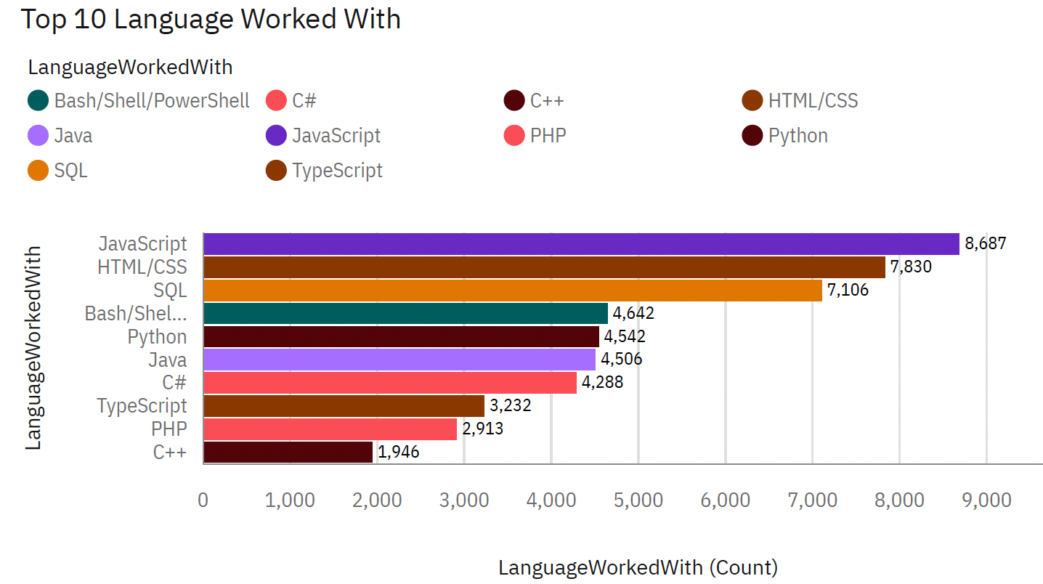
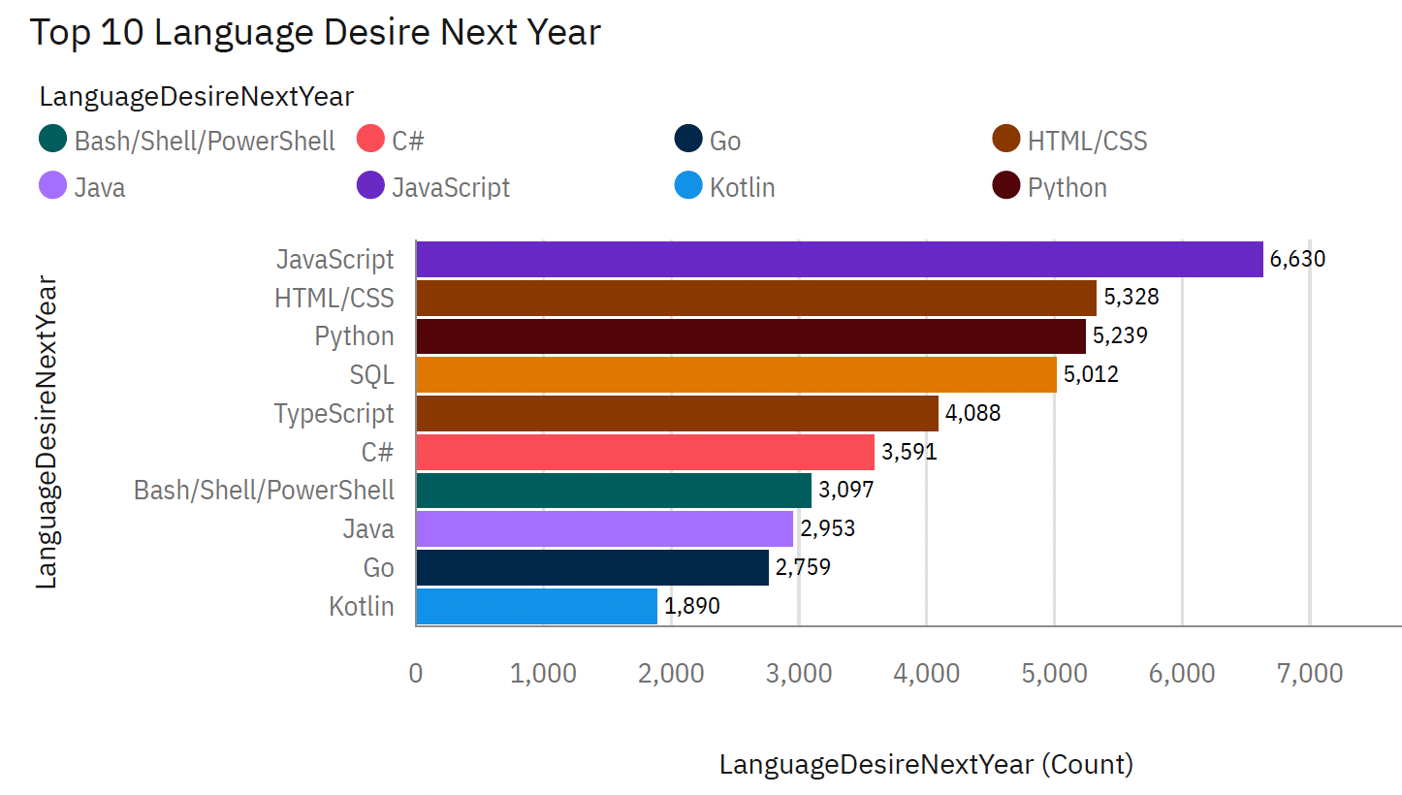
PROGRAMMING LANGUAGE TRENDS
Current Year
Next Year
<Bar chart of top 10 programming languages for the current year goes here.>
< Bar chart of top 10 programming languages for the next year goes here.>

Slide 8
PROGRAMMING LANGUAGE TRENDS - FINDINGS & IMPLICATIONS
Findings
8 of the top 10 languages remain in demand for future
Python will have more demand than SQL
Mobile development languages are getting popular like Kotlin
C++ and PHP are getting relatively outdates
Implications
Web development skill has highest demand
Python is gaining more traction due to increase in ML & AI skills
Languages that enhance the current coding languages are gaining popularity eg TypeScript

Slide 9
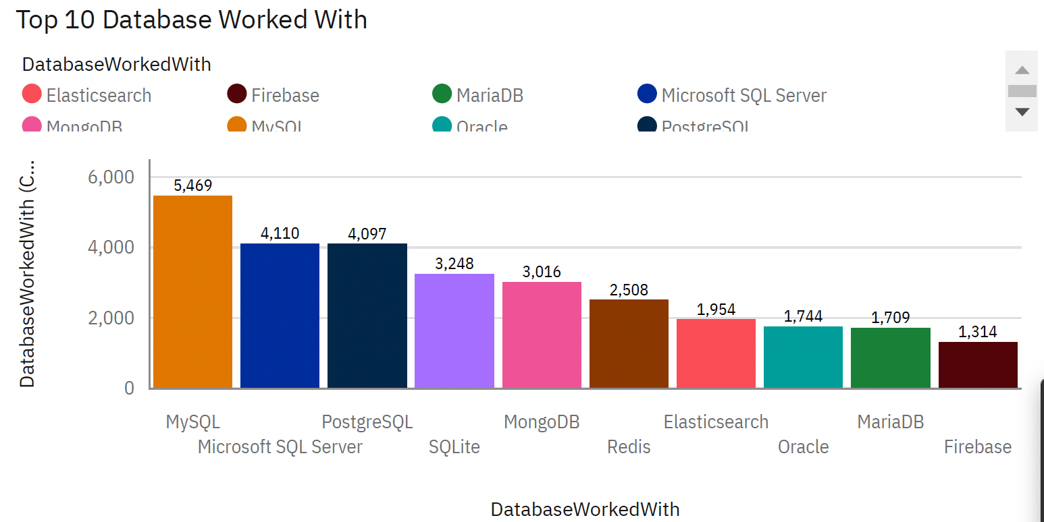
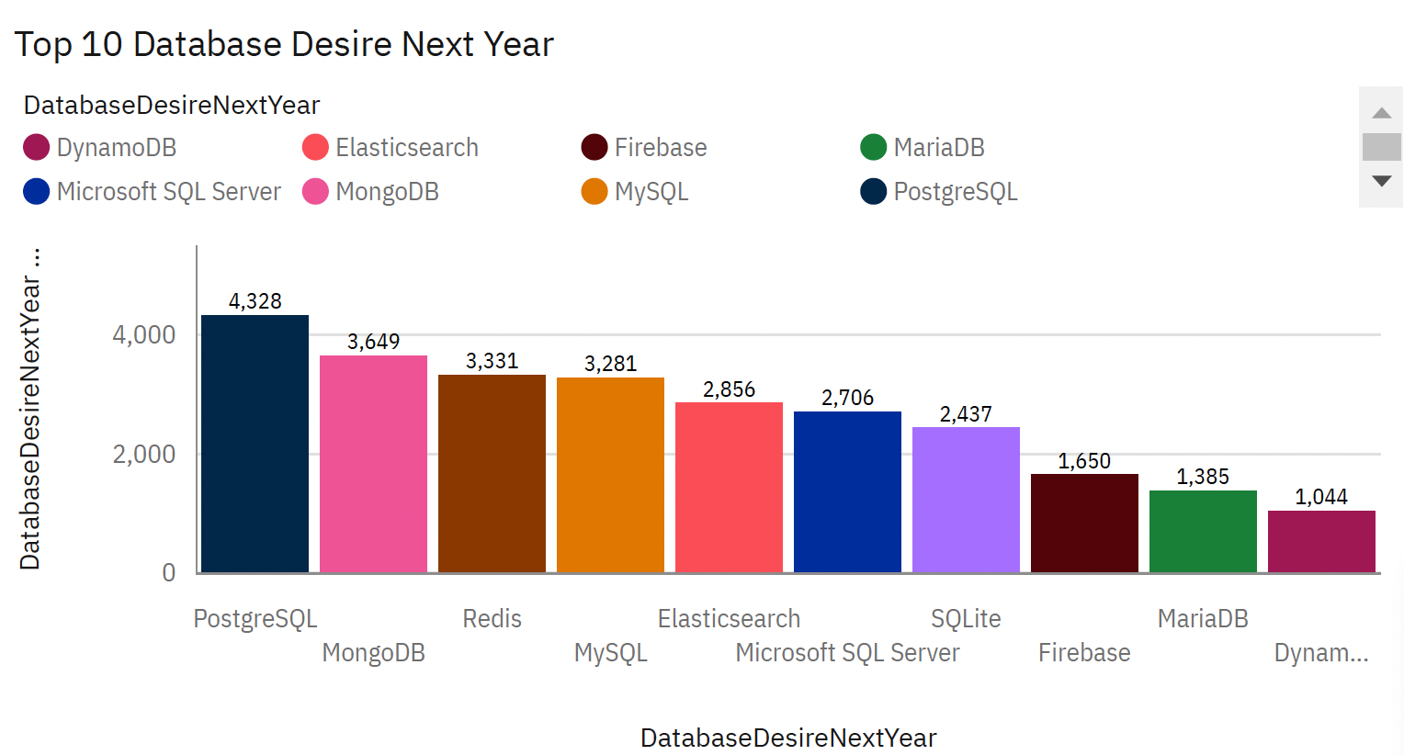
DATABASE TRENDS
Current Year
Next Year
< Bar chart of top 10 databases for the current year goes here >
< Bar chart of top 10 databases for the next year goes here.>

Slide 10
DATABASE TRENDS - FINDINGS & IMPLICATIONS
Findings
9 out of top 10 databases remain in demand for future
DynamoDB is increasing in popularity whereas Oracle is decreasing
MongoDB has gained a lot of popularity
MySQL will be replaced by PostgreSQL as the most popular DB
Implications
Markets don’t need to change to newer Databases
Companies prefer OpenSource databases
Big Data is becoming increasingly useful for analysis
Shift towards more NoSQL based DBs is foreseen

Slide 11

DASHBOARD
https://github.com/akshaykharbanda/IBM-Data-Analyst-Capstone-Project/blob/main/Capstone%20Project%20Dashboard.pdf

Slide 12
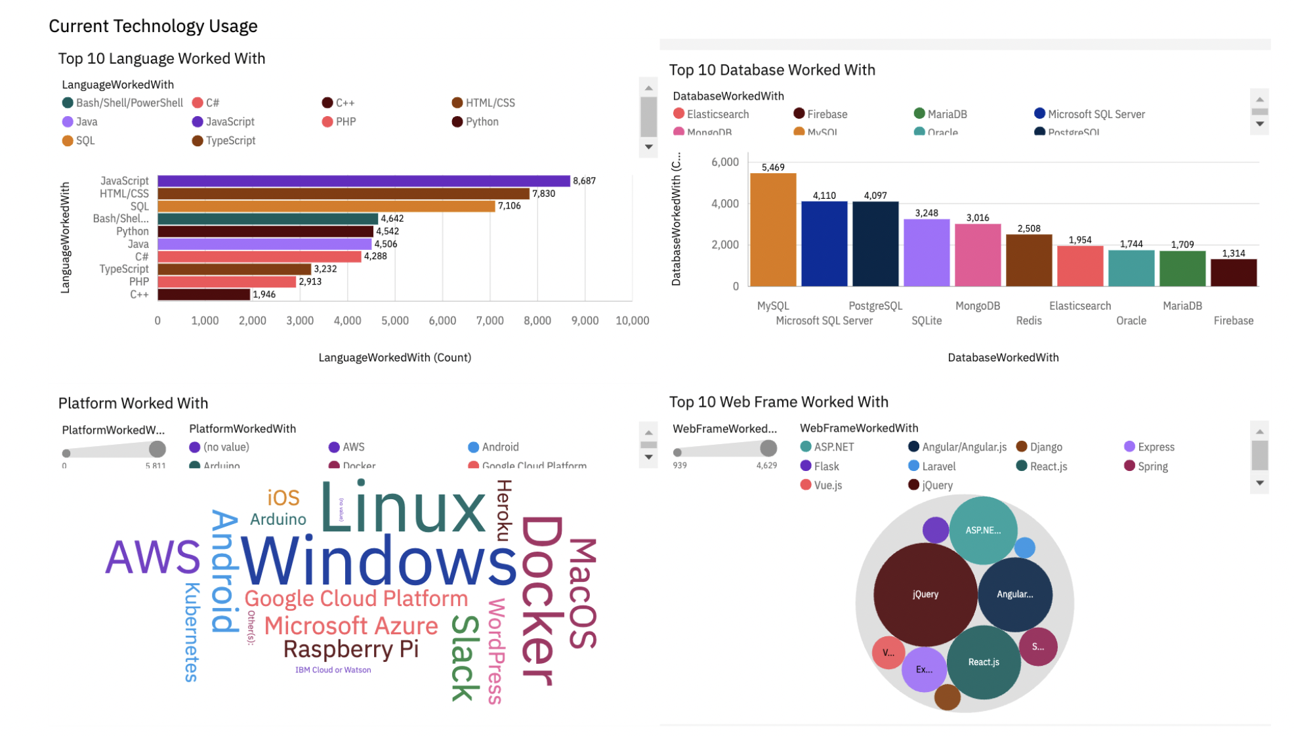
DASHBOARD TAB 1
Screenshot of dashboard tab 1 goes here

Slide 13
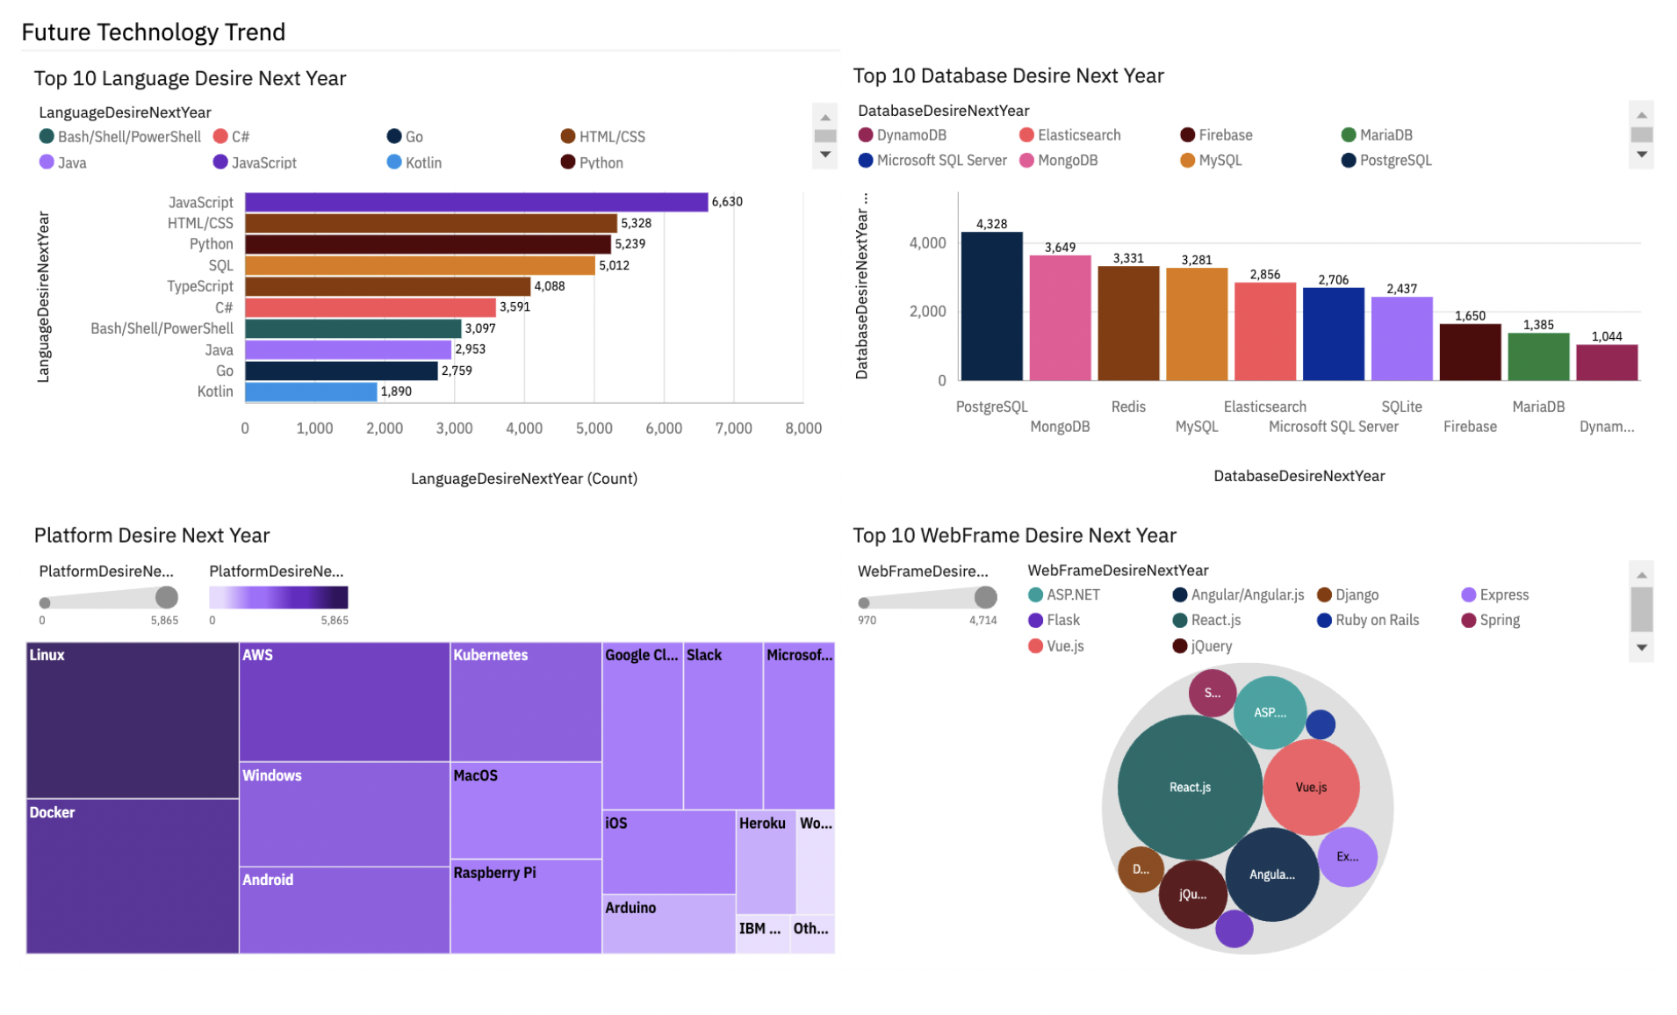
DASHBOARD TAB 2
Screenshot of dashboard tab 2 goes here

Slide 14
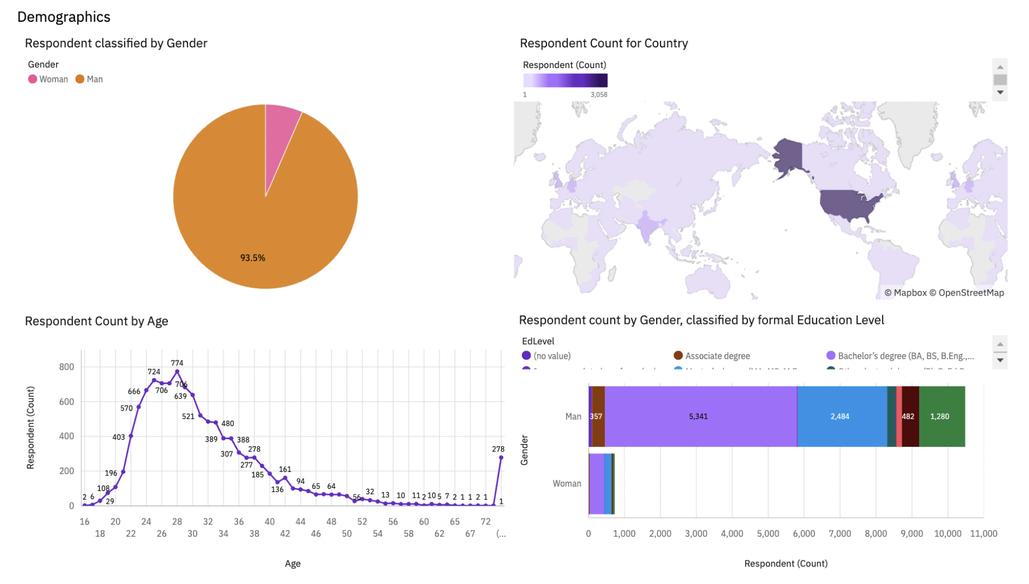
DASHBOARD TAB 3
Screenshot of dashboard tab 3 goes here

Slide 15
DISCUSSION
How do we enable tech enthusiasts to learn the languages in demand in future
Different factors determining compensation- age, ed level, gender, programming languages and DBs
How will the companies transition to newer DBs and languages
Increasing demand for mobile development as well as AI/ML

Slide 16
OVERALL FINDINGS & IMPLICATIONS
Findings
Most people in IT have bachelors’ degree
Web development languages are most popular
Majority people in tech are young in age
Database languages especially Python are gaining more popularity
Implications
Important for data professionals to develop proficiencies in NoSQL in addition to SQL databases
Web development is still a lucrative skill
Less developed countries need more access to tech education
There is an overall trend of shifting towards to ML/AI skills

Slide 17

CONCLUSION
It’s critical to upskill yourself based on the upcoming technology trends
Companies should constantly spend investment in newer technologies
Swift Transition to newer technologies are required to meet the demand of companies
Trends for other regions may vary as this data is primarily of US region

Slide 18

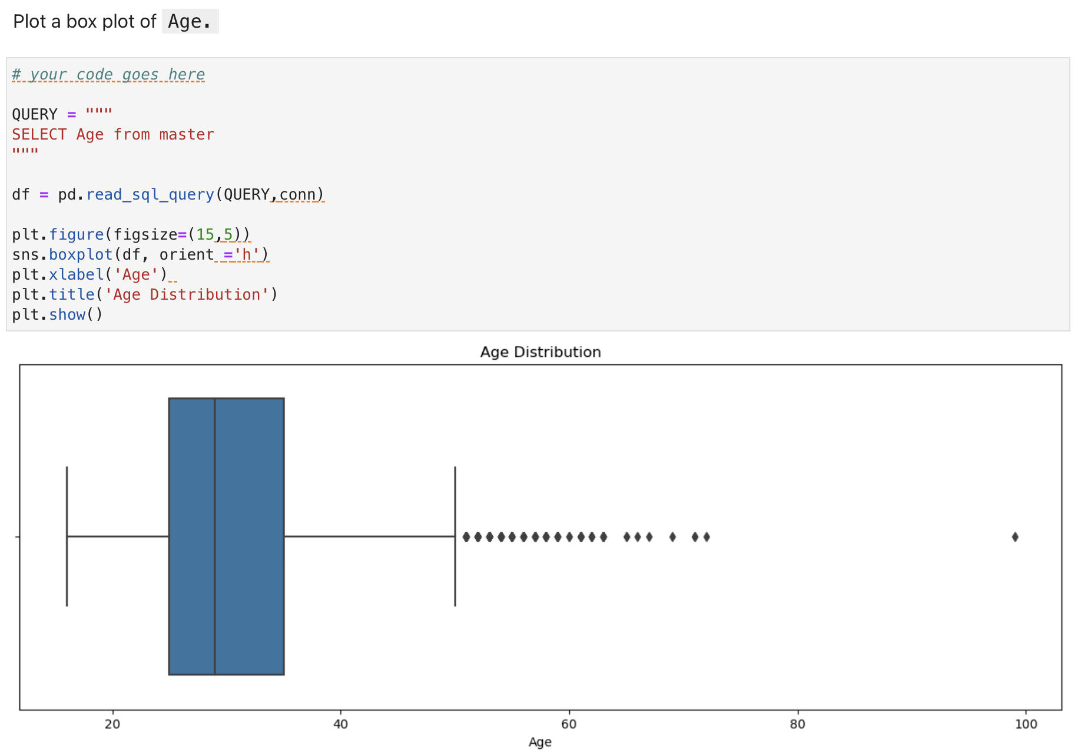
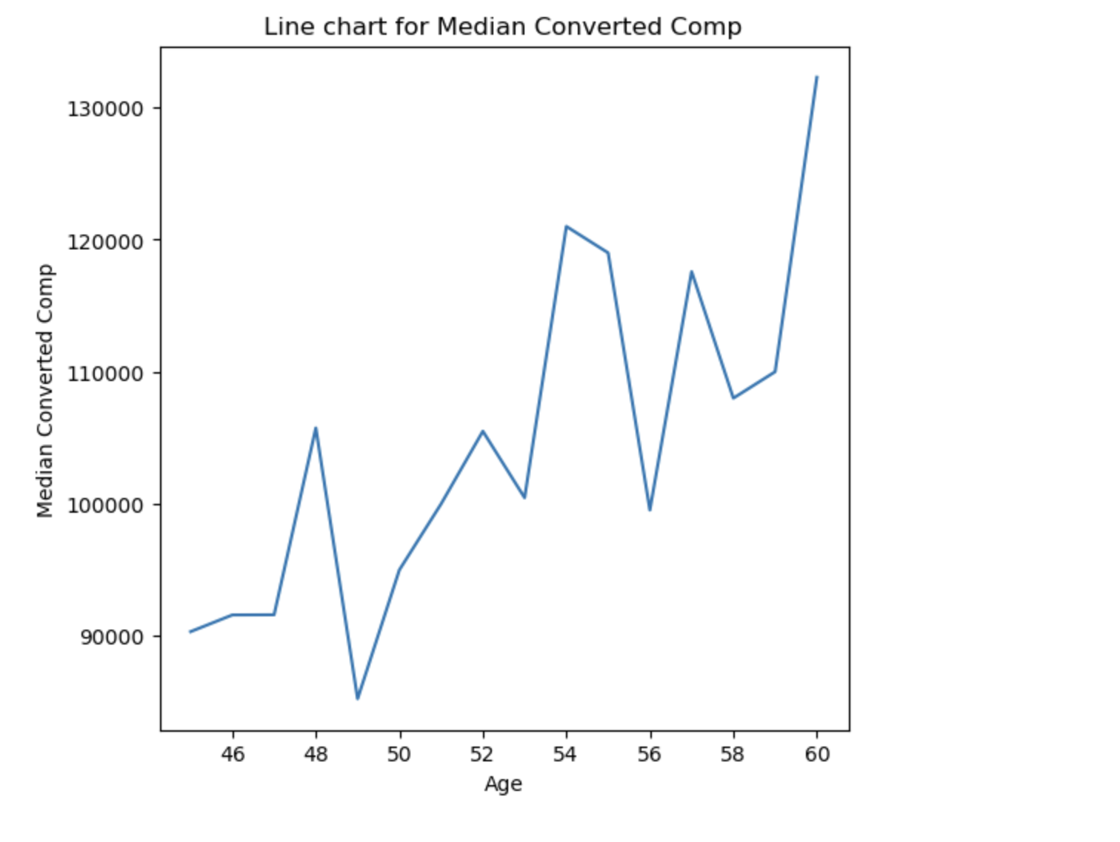
APPENDIX
Include any relevant additional charts, or tables that you may have created during the analysis phase.

Slide 19
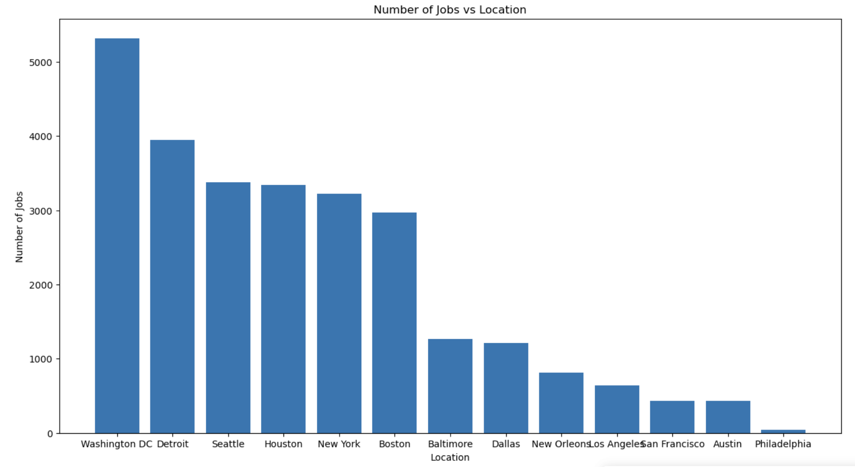
JOB POSTINGS
In Module 1 you have collected the job posting data using Job API in a file named “job-postings.xlsx”. Present that data using a bar chart here. Order the bar chart in the descending order of the number of job postings.
'Number of Jobs'

Slide 20
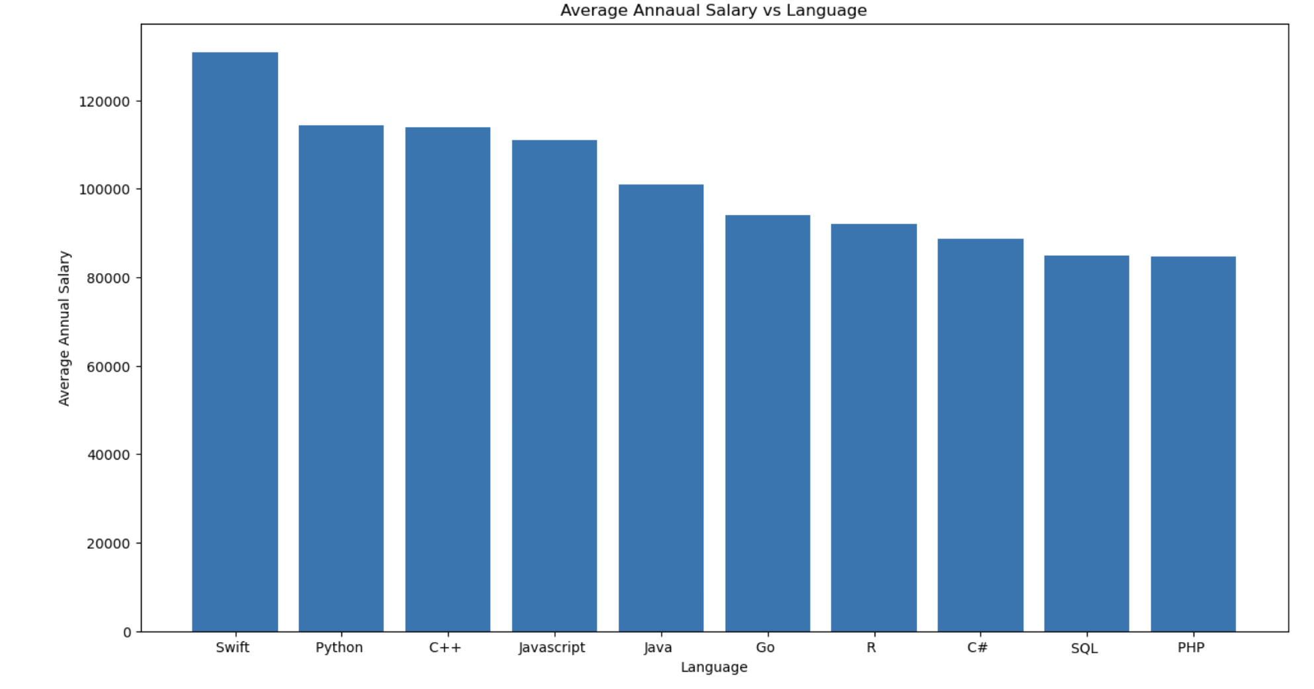
POPULAR LANGUAGES
In Module 1 you have collected the job postings data using web scraping in a file named “popular-languages.csv”. Present that data using a bar chart here. Order the bar chart in the descending order of salary.

